Slide 1
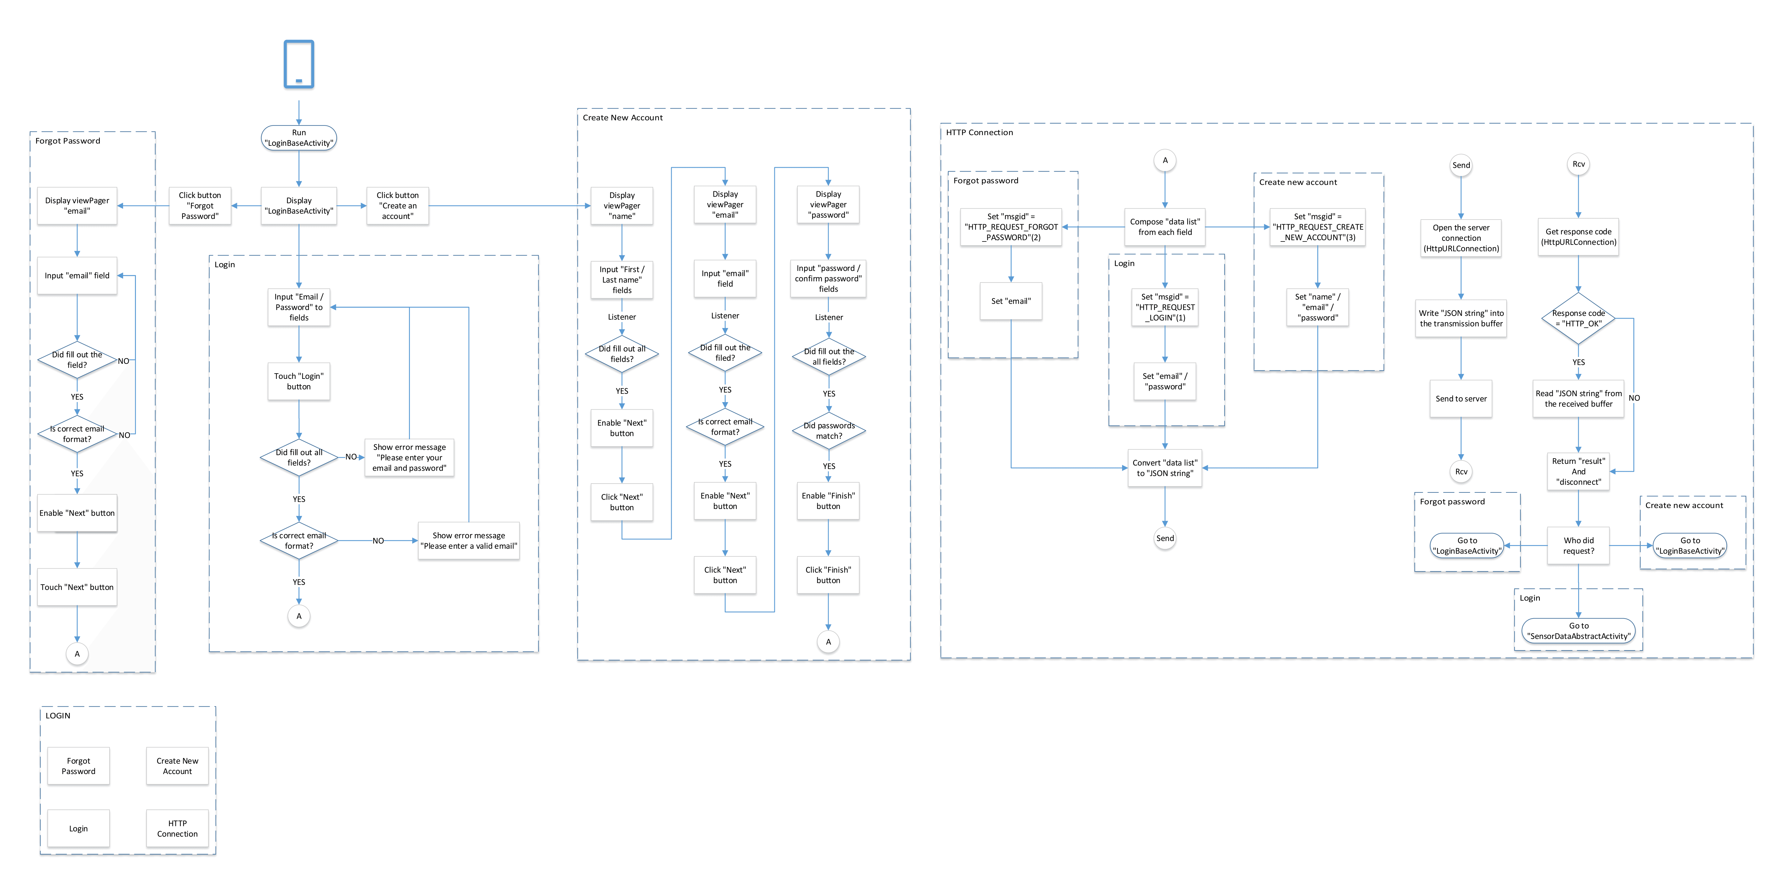
Login HTTP Communications

Slide 2
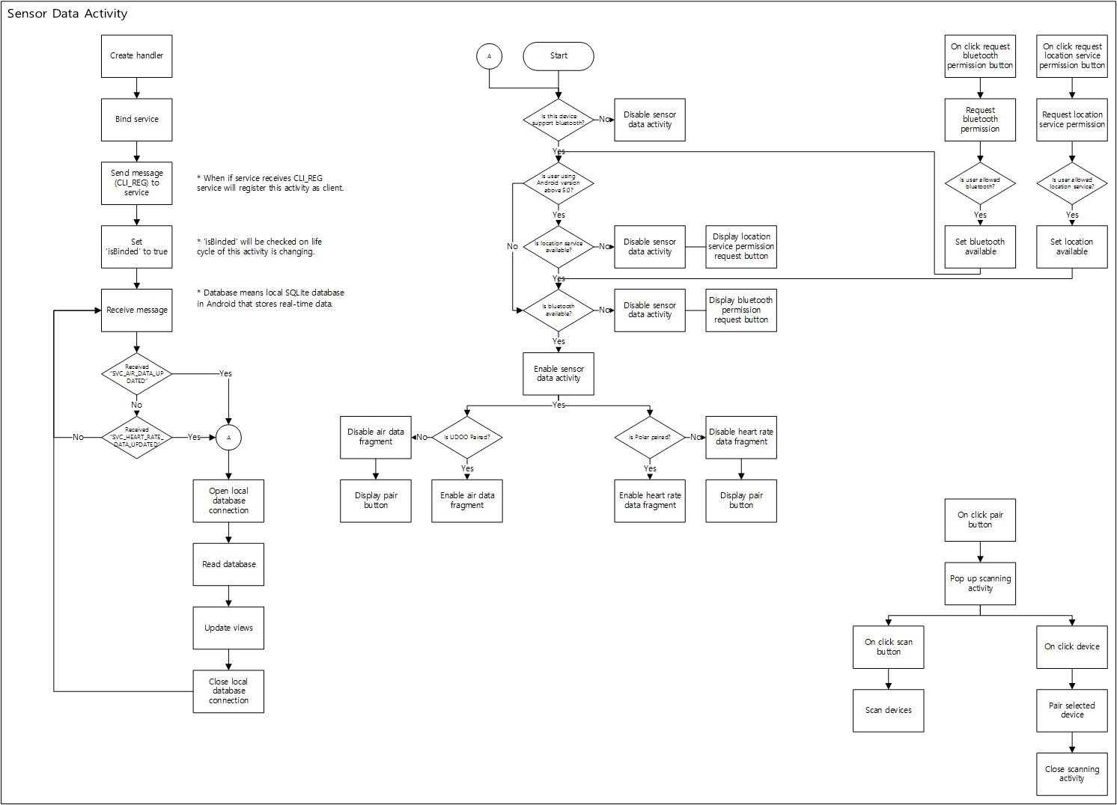
Sensor Data Activity

